Slide 1







Digital portfolio
Student Name: Subin U
Register no:asbrubd2428k0068
Department: BSC (AI&DS)
College:Shree Venkateshwara Arts and Science (co-education) College-Othakuthirai
University:Bharathiar University

Slide 2



Subin
Portfolio
Project
Title

Slide 3




Agenda
5
Portfolio design and
layout
problem statement
1
6
Features and Functionality
Project overview
2
End Users
3
7
Result and screenshot
Tools and Technologies
4
Conclusion and
GitHub Link
8

Slide 4


In today’s competitive world, resumes alone are not enough to showcase a person’s creativity, technical expertise, and career goals. Aspiring professionals like Subin, who aim to grow both as a Director and a Software Engineer, need a platform that highlights their skills, projects, and ambitions in a visually appealing and interactive way. Without such a platform, it becomes difficult to stand out, effectively communicate strengths, and connect with opportunities in both creative and technical industries.
Problem statement

Slide 5
The Subin Portfolio is a personal website built with HTML, CSS, and JavaScript to showcase Subin’s skills, projects, and career goals.
It highlights technical expertise, creative ambitions, and academic work in a visually engaging format.
This portfolio serves as a digital identity, combining technology and creativity to stand out in both film and software fields.
Project Overview

Slide 6
The end users of the Subin Portfolio are recruiters, professors, collaborators, and creative professionals who want to know about Subin’s skills and achievements.
They can easily explore technical expertise, academic projects, and career goals in a clear and engaging format.
The portfolio helps end users quickly evaluate Subin’s potential in both directing and software engineering.
End Users

Slide 7
The portfolio was developed using HTML, CSS, and JavaScript to create structure, design, and interactivity.
VS Code was used as the main editor, while CodePen helped in quick testing and experimenting with code.
Images were uploaded and managed using ImgBB for reliable hosting.
The project was tested across multiple modern web browsers for compatibility.
Techniques applied include responsive design, card layouts, form validation, and text animations to enhance user experience.
Tools and Technologies

Slide 8


The portfolio follows a light theme with a silver background and purple accents for a clean, modern look.Content is organized into clear sections such as About Me, Skills, Projects, Goals, and Contact.A card layout is used for projects to displaydetails in an engaging way.
The design is responsive, ensuring proper display on desktops, tablets, and mobile devices.Visual enhancements like frames, hover effects, and animations make the layout more interactive and appealing.
Portfolio Design and Layout

Slide 9



The portfolio provides an About Me section with a photo and animated introduction.
It showcases technical skills, soft skills, and languages in a structured format.
Projects are displayed using an interactive card-based layout for clarity.
A Goal section highlights career ambitions in a casual, engaging paragraph.
The Contact form includes validation for ID, subject, and message, making communication simple and reliable.
Features and Functionality

Slide 10
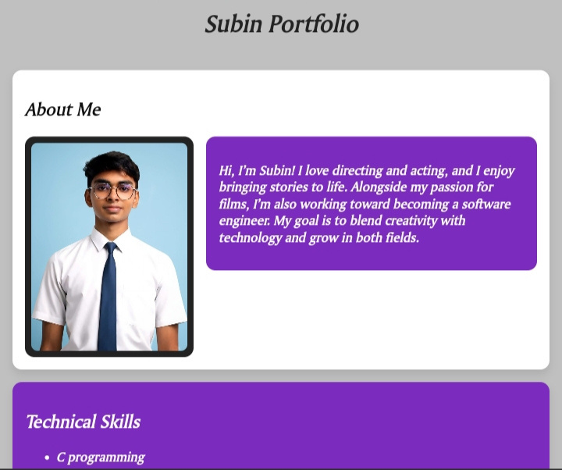
Result and screenshot

Slide 11
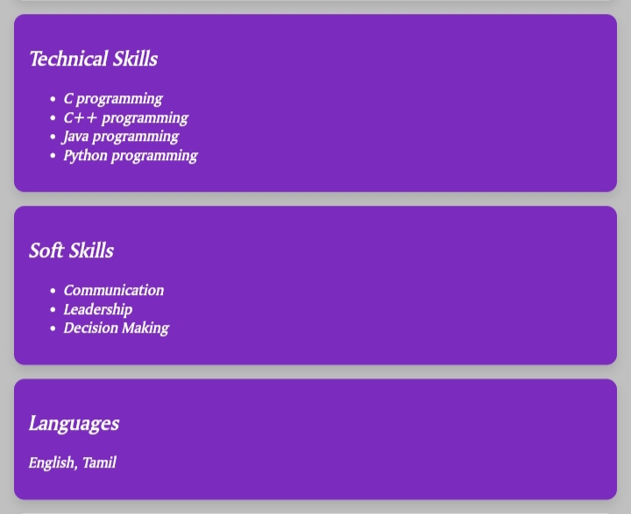

Slide 12
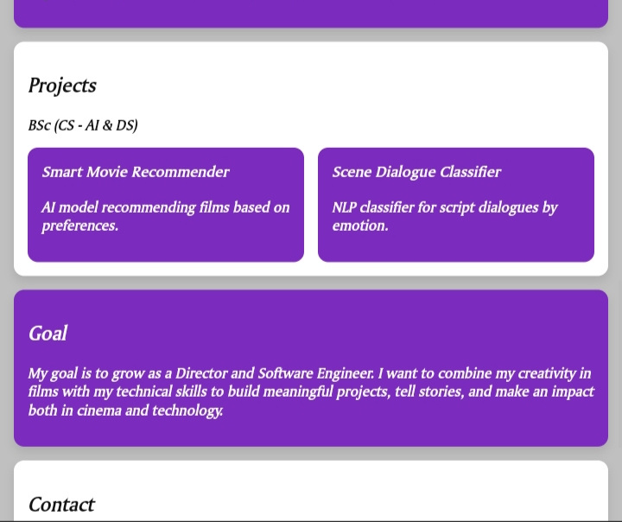

Slide 13
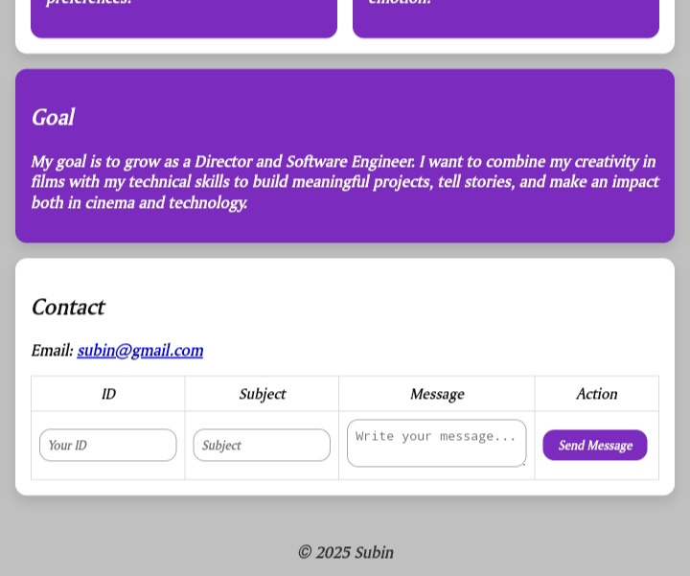

Slide 14


The Subin Portfolio successfully showcases personal, technical, and creative skills in a structured way.It provides a digital identity that highlights both software expertise and directing ambitions.The use of HTML, CSS, JavaScript, ImgBB, and CodePen ensures a modern and interactive design.Its responsive layout and functional contact form make it user-friendly across devices.Overall, the portfolio reflects Subin’s ability to blend creativity with technology for future opportunities.
Conclusion

Slide 15


GitHub Link 🔗
https://github.com/subin8023/Subin-digital-portfolio-.git

Slide 16

Home
Service
About Us
Contact
Thank
You

